Slide 1

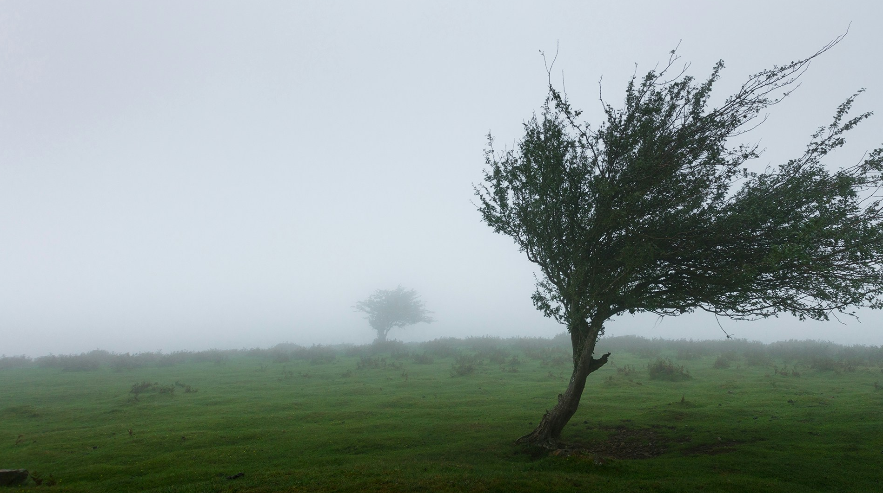
Building a Resilient
Ministry Team
Bending and Bouncing Back Better
Timothy Janzen, Lead Pastor
Warwick Assembly
HV Section - Presbyter

Slide 2

What does Resilient mean?

Slide 3
adjective: resilient
1. (of a person or animal) able to withstand or recover quickly from difficult conditions.
Similar: strong; tough; hardy; quick to recover; quick to bounce back; buoyant; difficult to keep down; irrepressible;adaptable;flexible
Opposite: vulnerable; sensitive
Oxford English Dictionary Languages

Slide 4
adjective: resilient
2. (of a substance or object) able to recoil or spring back into shape after bending, stretching, or being compressed."a shoe with resilient cushioning"
Similar: flexible; pliable; pliant; supple; plastic; elastic; springy; rubbery; durable; hardwearing; stout; strong; sturdy; tough
Oxford English Dictionary Languages

Slide 5
The ability to bend but not break; to change without compromising convictions; adapt, absorb, recover, and thrive in an ever-change culture.

Slide 6
”But we have this treasure in jars of clay to show that this all-surpassing power is from God and not from us. We are hard pressed on every side, but not crushed; perplexed, but not in despair; persecuted, but not abandoned; struck down, but not destroyed.“
2 Corinthians 4:7-9 NIV

Slide 7

What are the character components of Resilience?

Slide 8


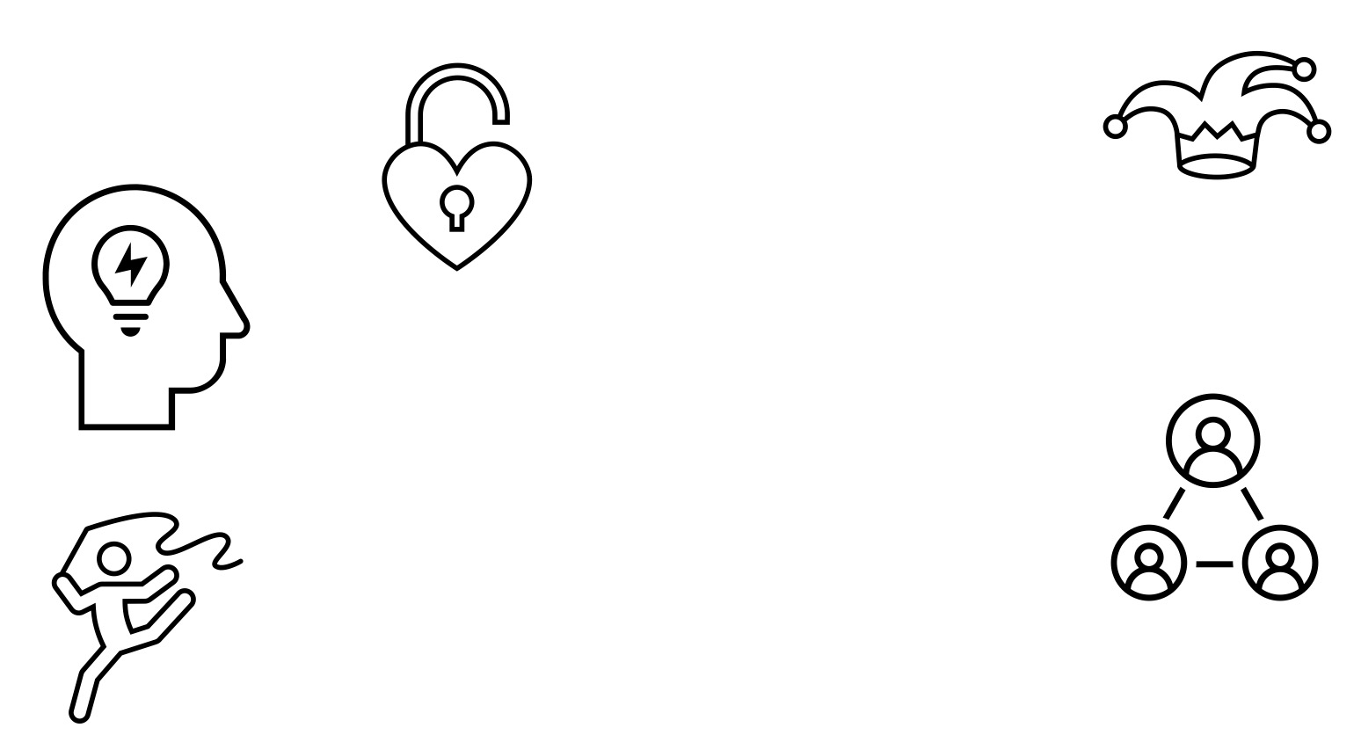






Optimism
Self-Control
Social Support
Resilience
Willingness to Adapt
Sense of Humor
Willingness to be Flexible
Ability to Solve Problems
Emotional Awareness
adapted from motivationallines.com

Slide 9
Building Blocks of a Resilient Ministry Team

Slide 10






Don’t Blame Themselves or Others
Think Positively
Resilient Teams
Sees Challenges
Commit to goals
Focus on What They Can Control
adapted from motivationallines.com

Slide 11
Ways to Become a More
Resilient Team

Slide 12
Do something in a new way
Make a goal and double it
Absorb a hit without hitting back

Slide 13
Remain positive when problems / difficulties arise
Be honest!
Try something whole heartedly that was someone else’s idea

Slide 14
Give permission to fail
Keep systems flexible
Try to anticipate the next major change and move in that direction

Slide 15
REMEMBER…

Slide 16
YOU WERE MADE FOR THIS!
“…you were made…for just such a time as this?”
Esther 4:14

