Slide 1
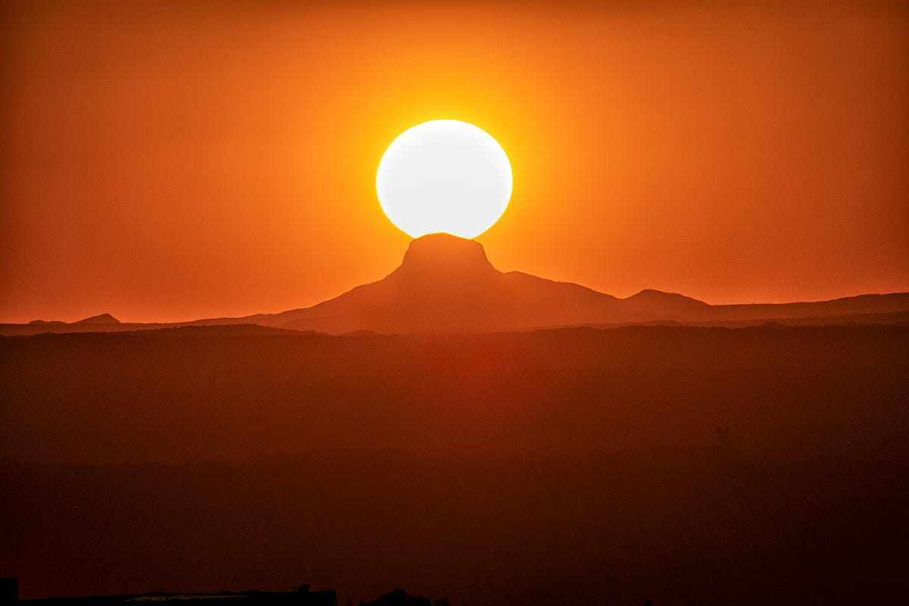
Equipping Boys to be Spiritually Discerning Men
(Fighting Battles for Others-Joshua 1-12)
A.J. Pandolfo
Royal Ranger Outpost Coordinator
The Mission Church
(c) 475-289-1887
pandolfos@comcast.net

Slide 2
1. Stepping into Leadership
Joshua 1:2 “Moses … is Dead…”

Slide 3
2. Strategy Perspective
Joshua 2:1 “Then Joshua son of Nun secretly sent two spies from Shittim. “Go, look over the land,” he said, “especially Jericho.” So they went and entered the house of a prostitute named Rahab and stayed there.”

Slide 4
3. Get Instructions from God
Joshua 3:11-13 “See, the ark of the covenant of the Lord of all the earth will go into the Jordan ahead of you. Now then, choose twelve men from the tribes of Israel, one from each tribe. And as soon as the priests who carry the ark of the Lord—the Lord of all the earth—set foot in the Jordan, its waters flowing downstream will be cut off and stand up in a heap.”

Slide 5
4. Hope for the Future
Joshua 4 “…He said to the Israelites, “In the future when your descendants ask their parents, ‘What do these stones mean?’ tell them, ‘Israel crossed the Jordan on dry ground.’…

Slide 6
5. Understand God’s Heart
Joshua 5:13-15 “Now when Joshua was near Jericho, he looked up and saw a man standing in front of him with a drawn sword in his hand. Joshua went up to him and asked, “Are you for us or for our enemies?” “Neither,” he replied, “but as commander of the army of the Lord I have now come….”

Slide 7
6. Victory is clearly from God
Joshua 6-We know the story. That was not a man’s victory!

Slide 8
7. Identify the Root of the Problem
Joshua 7:8 “…What then will you do for your own great name?”

Slide 9
8. God’s Way is the Only Way
Joshua 8-The Fall of Ai-God does doesn’t follow the same formulas.

Slide 10
9. Pray or You May Make Bad Decisions
Joshua 9:14 “The Israelites sampled their provisions but did not inquire of the Lord. “

Slide 11
10. Sometimes You have to Fight Other People’s Battles!
Joshua 10:12-15 “On the day the Lord gave the Amorites over to Israel, Joshua said to the Lord in the presence of Israel:
“Sun, stand still over Gibeon,
and you, moon, over the Valley of Aijalon.”
So the sun stood still,
and the moon stopped,
till the nation avenged itself on its enemies,
as it is written in the Book of Jashar.
The sun stopped in the middle of the sky and delayed going down about a full day. There has never been a day like it before or since, a day when the Lord listened to a human being. Surely the Lord was fighting for Israel!”

Slide 12
11. God Gives Rest
Joshua 11:23 “…Then the land had rest from war.”

Slide 13
12. God knows the victories we need
Joshua 12:23 “…thirty-one kings in all.”

Slide 14
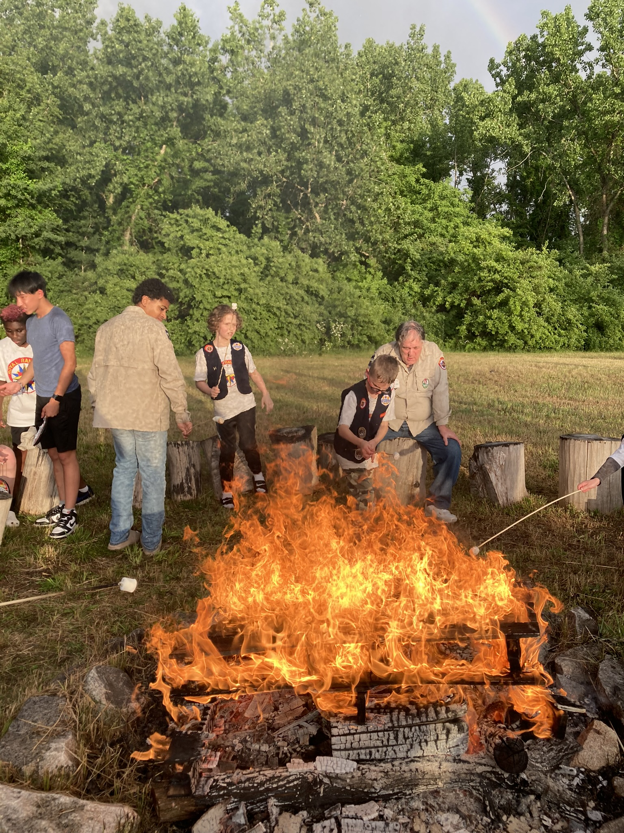
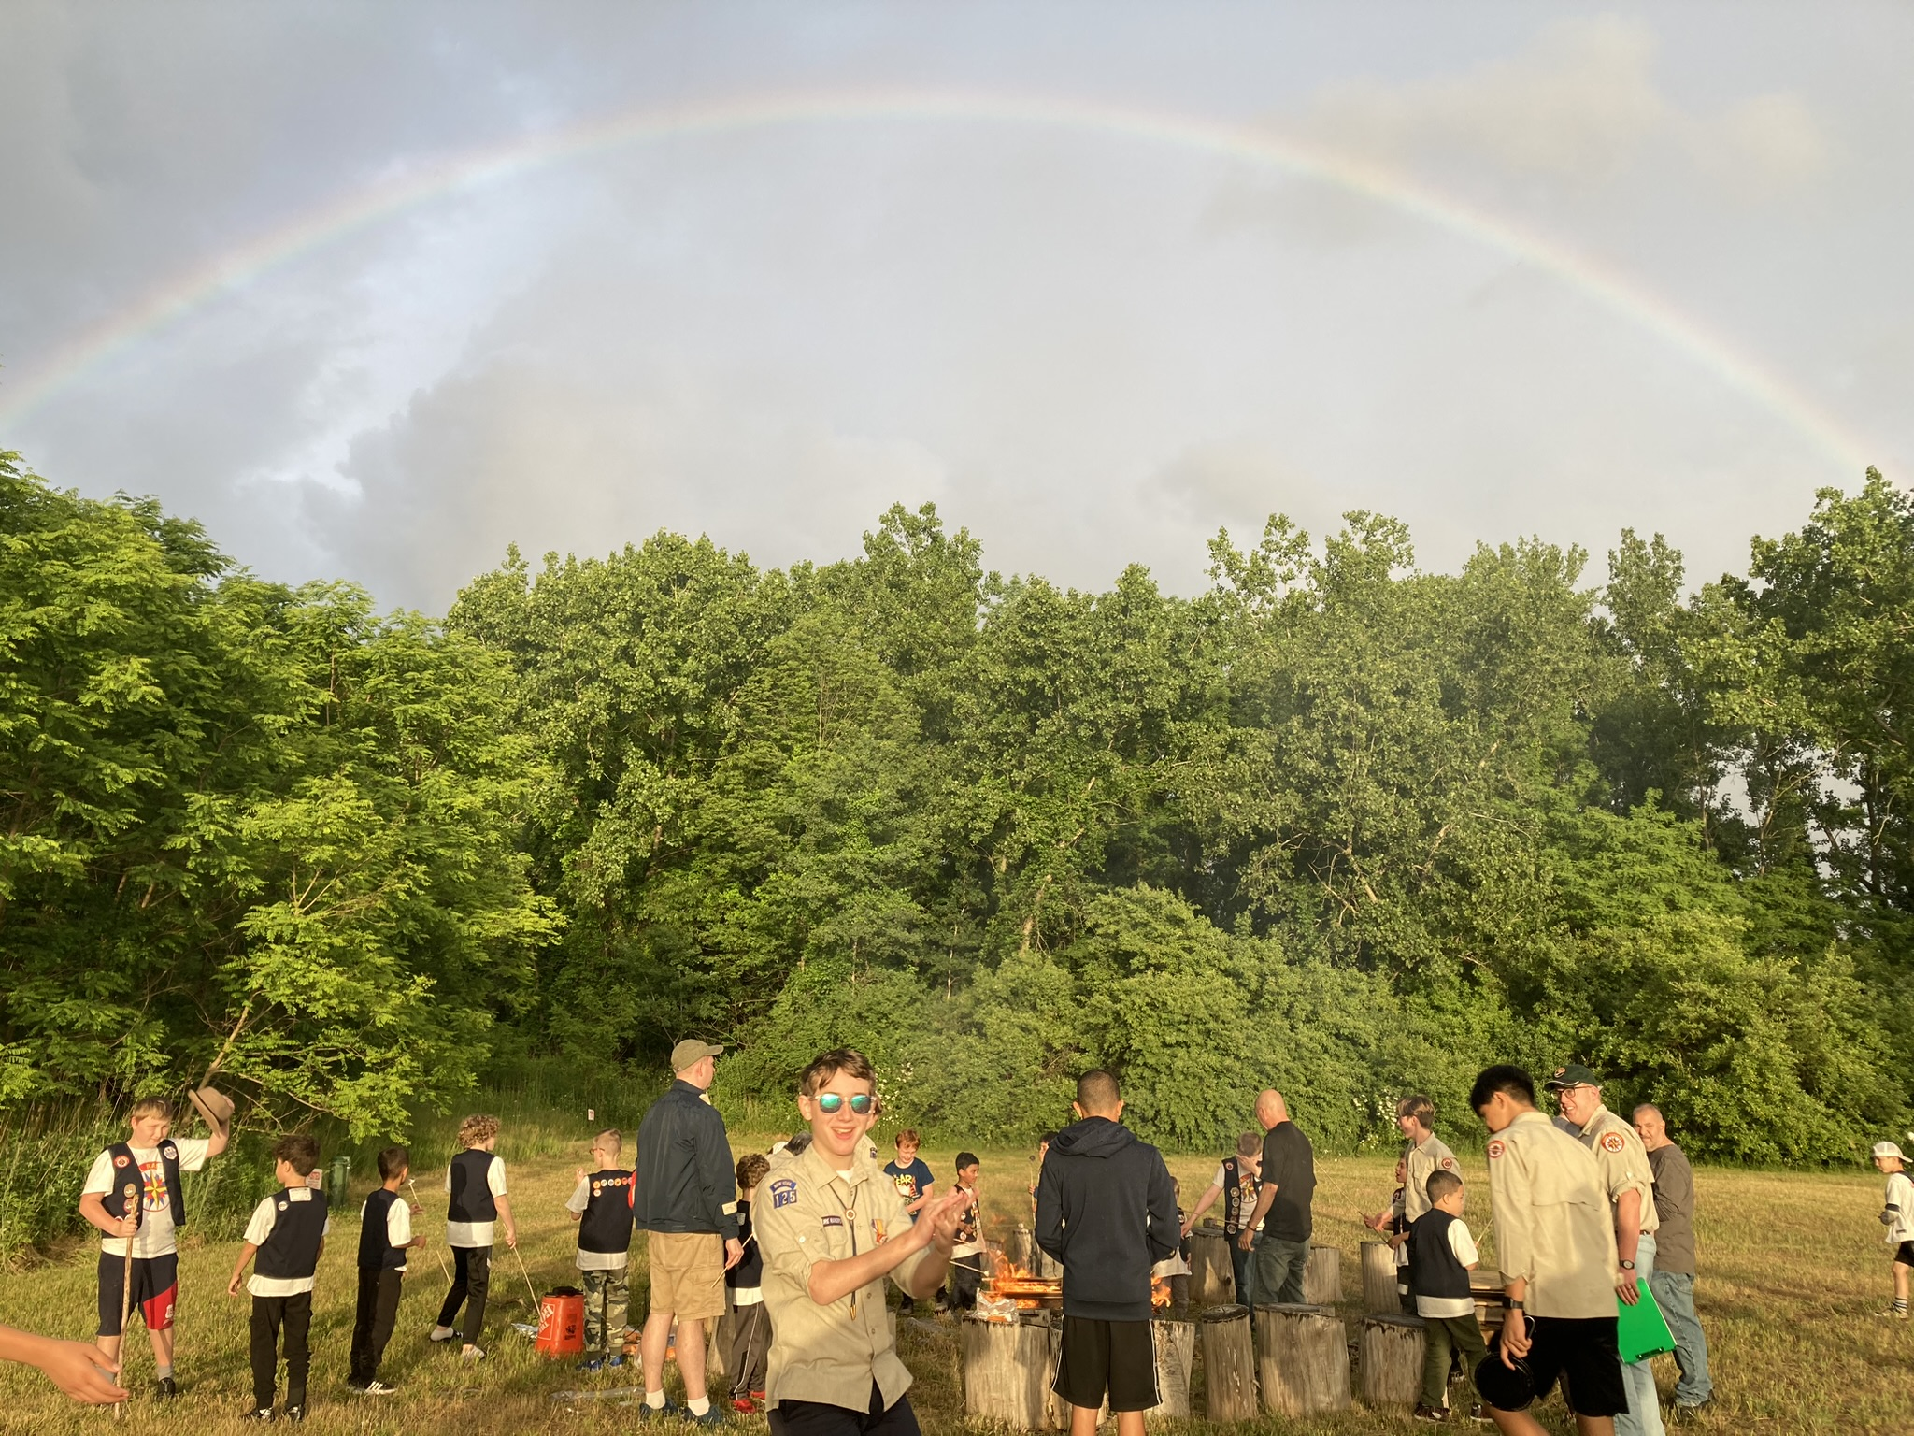
A.J. Pandolfo
The Mission Church
475-289-1887
pandolfos@comcast.net

