Slide 1
What do you See?
https://www.youtube.com/watch?v=VQGjUUUzX6g

Slide 2



MOMENTUM TRAINING SERIES

Slide 3


Including Children with Disabilities
You arrive to church early to set up for your class when a church leader brings in a new child with her parents and introduces them to you. The parents tell you that their child has autism, so she may not respond to questions or talk to other kids.
Are you ready to include this child into your group?
Are you confident in your abilities to teach her?
Notes:
Including Children with Disabilities pg. 1
Some of you may have concerns about teaching children with disabilities, but you don’t need to feel overwhelmed.

Slide 4

“Now may the God of peace…equip you with everything good for doing His will and may He work in us.”
Hebrews 13: 20-21
The fact is that God does not call the qualified…
He qualifies the called!
You are equipped!
Notes:
Including Children with Disabilities Page 1
This training will increase your awareness of children with disabilities and give you tools to teach those with a variety of abilities & limitations.
Understanding each child in your class will change the way you prepare your lesson

Slide 5

People-First Language
When people are described by a medical diagnosis, it devalues them as individuals.
Using people-first language focuses on the person first and then adds what a person has.
Notes:
What Are the Distinctives of Children with Disabilities? Page 2
Your primary role is to see each child as an individual with strengths, hopes, dreams and potential
Heather: “each one has a super power” – you just have to figure out what it is
We have to be careful not to put people into categories or make assumptions
When we describe someone just by their medical diagnosis it devalues them as a person
People First Language
The term “handicapped” is an outdated term and can be offensive. “Individuals with disabilities” supports People-First Language.

Slide 6

Intellectual
Disabilities
Notes:
Intellectual Disabilities Page 3

Slide 7

Intellectual Disabilities
A child with an intellectual disability may have difficulty in these areas:
  Understanding complex ideas
  Learning new concepts quickly
  Memorizing passages
  Remembering the sequence of instructions
  Making a plan to complete a task or solve problems
  Learning from their experiences
  Applying something they learned in one setting to a different setting
  Remembering something they previously learned
Notes:
Intellectual Disabilities Pages 3 & 4
You can’t look at someone and determine they have an intellectual
Formerly called “Mental Retardation,” Rosa’s Law changed the terminology to “Intellectual Disability” in 2010. The term “retardation” is no longer an appropriate way to describe a disability. While the term “retarded” literally means something that is delayed, it disrespects people with disabilities because it associates the slow thinking process with lack of intelligence and inferiority. It can be as offensive as calling someone stupid.

Slide 8
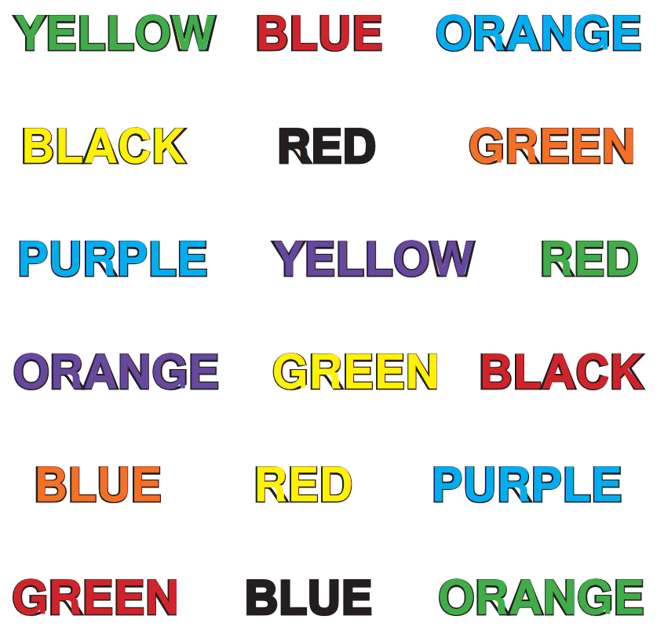
Notes:
Activity Suggestion
There are many different kinds of learning disabilities and they can range from mild to severe. This activity gives a general idea what it is like to have to struggle against what your brain may be telling you:
Ask the class to read out loud the COLOR the word is written in, not the word itself.
Afterward, discuss how your brain wants to read the actual word. Even when you can make yourself do it correctly, you have to read much slower than normal.
This is an example of how difficult it is for students with learning disabilities to get through the day. Their brain understands what needs to be done, but they have to struggle to make it come out right.

Slide 9
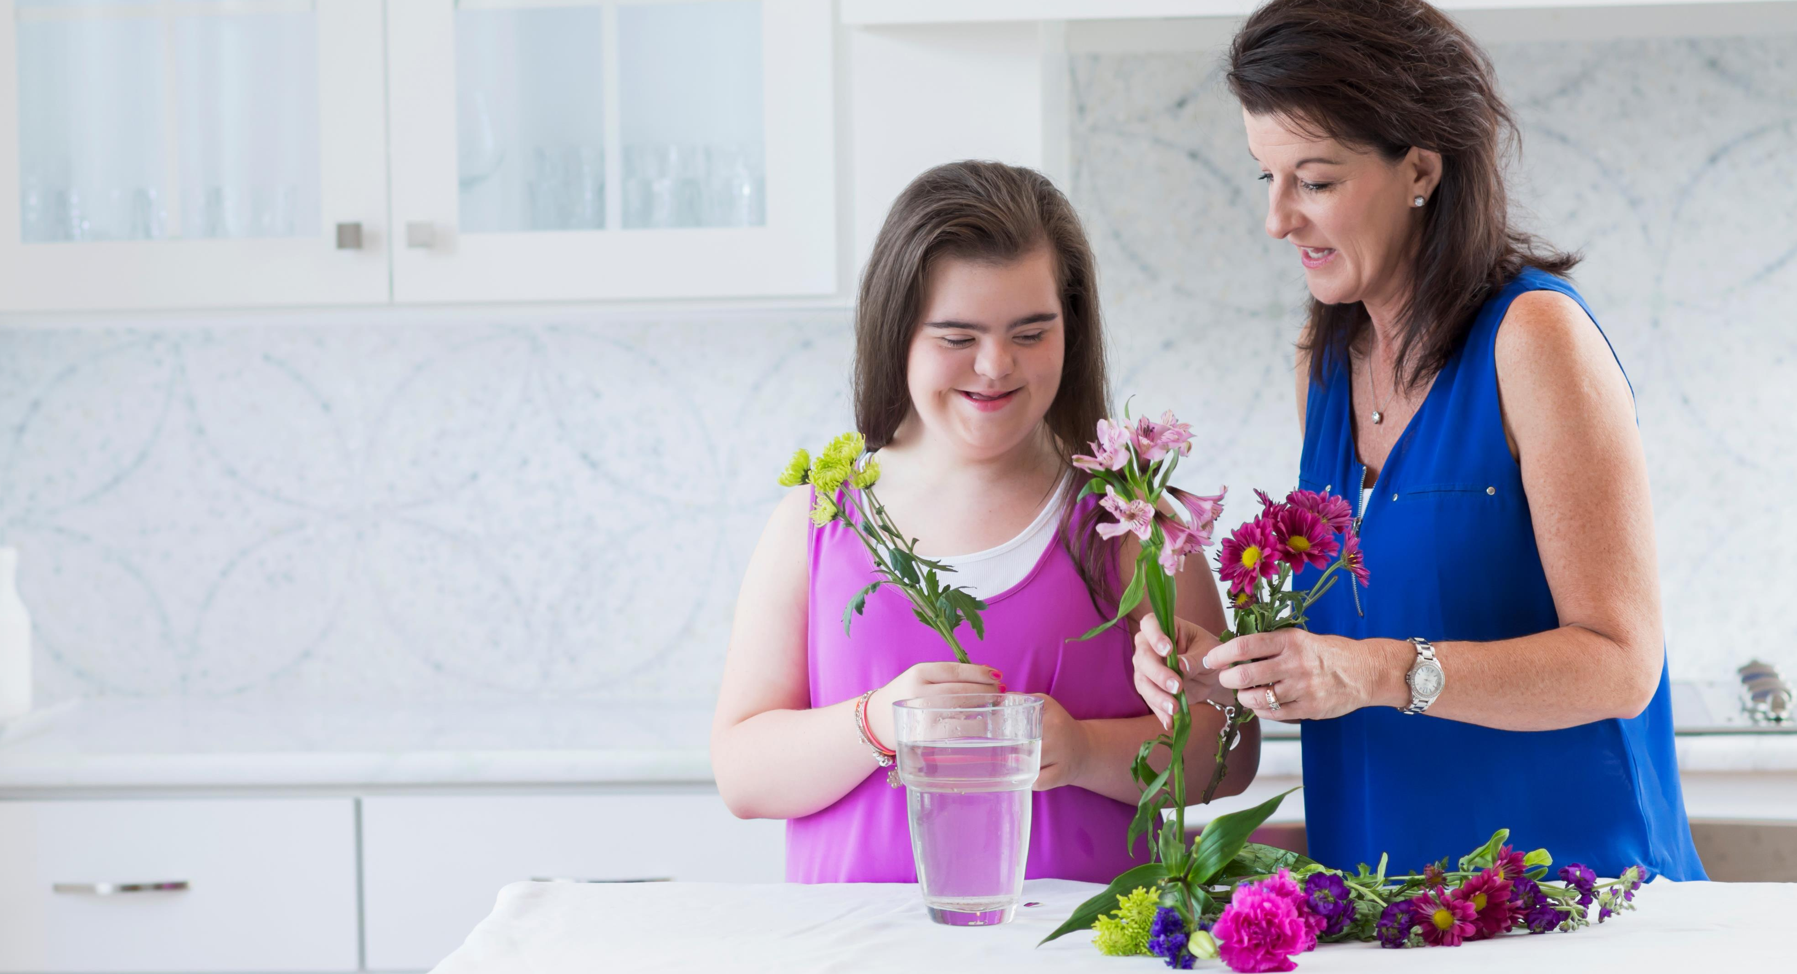
Common Limitations for Individuals with Intellectual Disabilities
Taking care of personal needs
Following the rules
Interacting with other children
Being responsible
Being aware of safety issues
Notes:
Intellectual Disabilities Page 5
Taking care of personal needs – using the toilet, feeding themselves, taking off a jacket.
Following the rules – understanding what the rules are, remembering the rules, knowing the reason for rules.
Interacting with other children – saying “hi” and “goodbye,” starting a conversation, knowing what is socially acceptable, asking and answering questions.
Being responsible – seeing the need to clean up an area, admitting to a mistake, keeping track of personal belongings.
Being aware of safety issues – knowing why it’s important to stay in a specific area, understanding the dangers of fire, electricity, water, heights, etc.
Remember that those with an intellectual disability continue to function at their level while peers outgrow these stages.

Slide 10

Developmental
Disabilities
Notes:
Developmental Disabilities Page 6

Slide 11
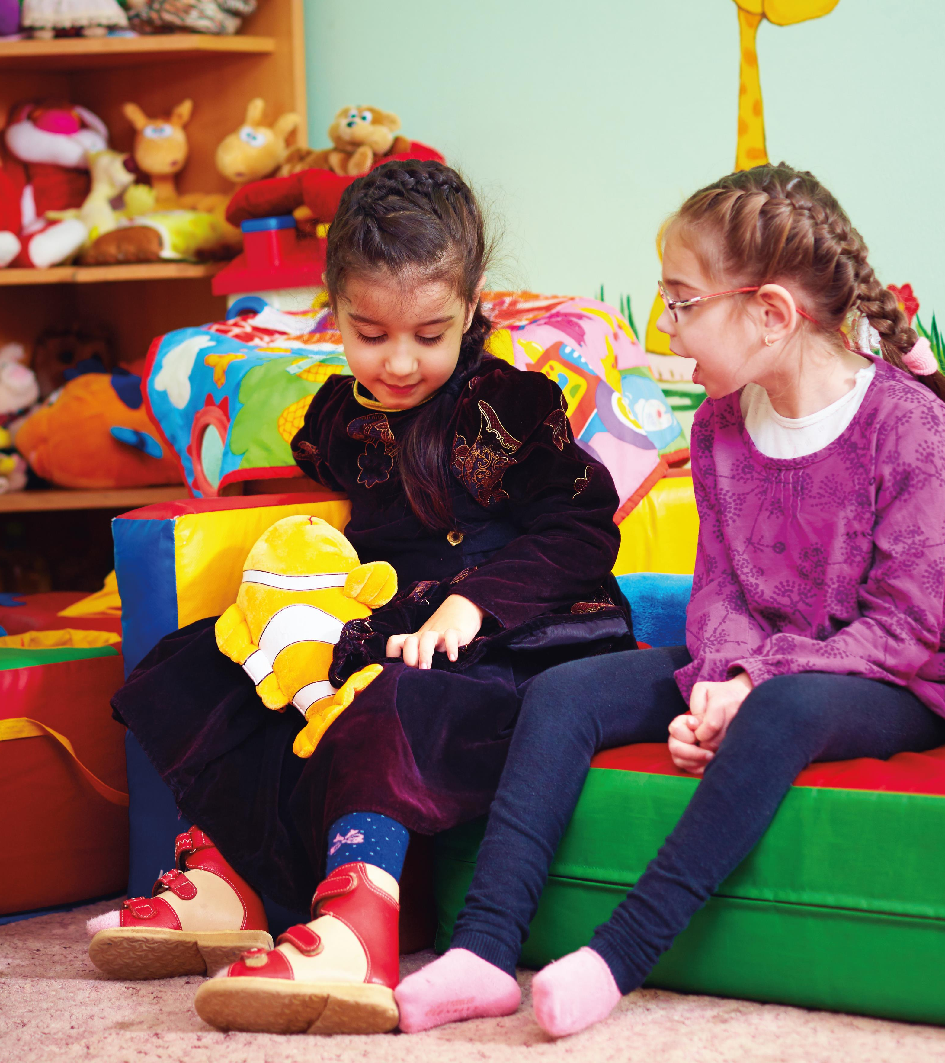
Developmental delays can be a physical or mental impairment or both
Limitations may include not being able to:
  Learn at a typical pace as other children
  Understand deeper, more complex concepts
  Be independent in self-care, including hygiene, toileting, and eating
  Communicate verbally and understand what they hear
  Move around independently
Notes:
Developmental Disabilities Page 6
Developmental delays can be a physical or mental impairment or both
Those with developmental disabilities will need others to support their learning and may need lifelong assistance with daily living. Some will need less, others will need more.

Slide 12

  Autism spectrum disorder (ASD) is a common developmental disability that can cause significant social, communication, and behavioral challenges
Notes:
Looking Closer at Autism Page 7

Slide 13

Looking Closer at Autism
  Communication and Social Interaction
    Personal Space
    Conversation
    Interaction
    Expressing Emotions
    Eye Contact
    Friendships
Notes:
Looking Closer at Autism Pages 7 & 8
Autism spectrum disorder (ASD) is a common developmental disability that can cause significant social, communication, and behavioral challenges.
Be sure to note that these suggestions are not only helpful for children with autism, but all children.

Slide 14
How Can I Support Children with Disabilities?
Preparing Your Lesson
Communication Techniques
Creating Visual Schedules
Helping Students Build Friendships
Managing Behaviors
Modeling and Training
  Practices used for children with autism can be effective for all children
Notes:
How Can I Support Children with Disabilities Page 11
Practices used for children with autism can be effective for all children.
Children with autism learn and process information differently from other children.
Specific practices have been found to be effective in helping children with autism understand and learn.
Using these practices will make you a more effective teacher with all the children in your class.
Incorporating these practices into your teaching will help you be more prepared to provide any child extra support.
This portion of the training will focus on supporting children with disabilities through:
Preparing your lesson
Communication Techniques
Creating Visual Schedules
Helping Students Build Friendships
Managing Behaviors
Modeling and Training

Slide 15

Preparing Your Lesson
What to Do When Modifications Are Needed
Modification – when a child is involved in the same lesson as others but is provided with a different task or expectation.
  Fine Motor Skills
  Memorization
Notes:
What to Do When Modifications are Needed Page 12
You won’t need to plan two separate lessons, but you may need to make modifications and accommodations to your lesson plans or activities to help each child feel comfortable and successful.

Slide 16

Preparing Your Lesson
What to Do When Accommodations Are Needed
Accommodation – A change that is made to the classroom or instruction that allows a child to participate.
  Group Time
  Pair Work
  Quiet Zone
Notes:
What to Do When Accommodations are Needed Pages 12-13

Slide 17

Preparing Your Lesson
How to Create a Multisensory Learning Environment
At anytime in your class, children could be involved in these activities:
Listening
Speaking
Large, Gross-Motor Movements
Small, Fine-Motor Activities
Music
Tasting and Smelling
Notes:
How to Create a Multisensory Learning Environment Page 13
As you prepare your lesson, use a checklist to see that you are using different ways to:
Present lessons
Help children remember important points
Practice what they are learning

Slide 18
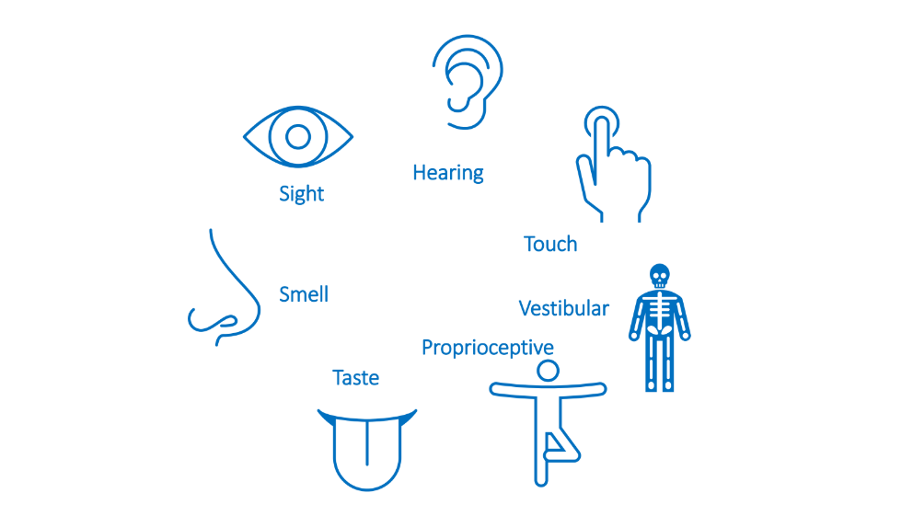

Slide 19
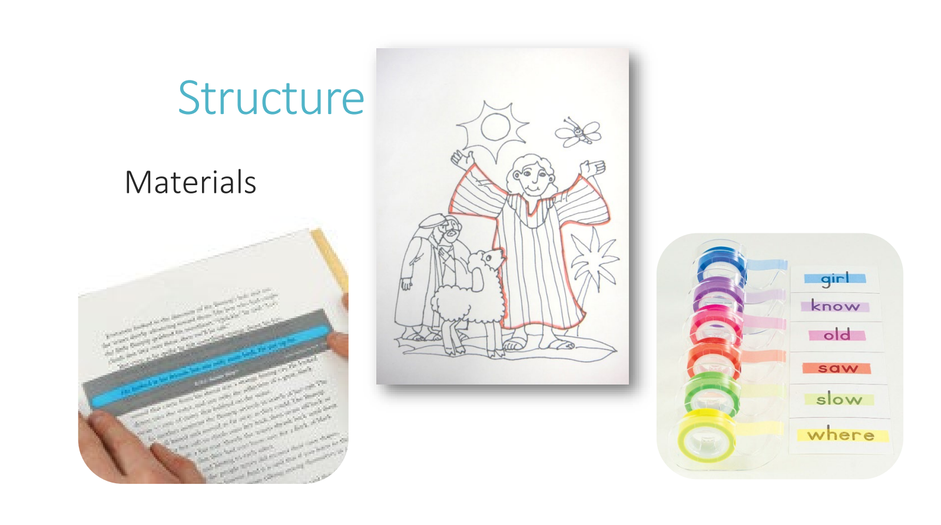
Notes:
Show highlighter tape

Slide 20
Communication Techniques
Allow Time to Process
Use Gestures or Pictures
  Rather than trying to get children with autism to look in your eyes, look for other signs that they are following along.
Notes:
Communication Techniques Pages 14-15
Communicating effectively with your students will help you build relationships with them.
Some children may be delayed in understanding what is said or in responding with an answer.
Some understand better with pictures or gestures.
Some children might understand better with fewer words instead of lengthy explanations.
Rather than trying to get children with autism to look in your eyes, look for other signs that they are following along.

Slide 21
Creating Visual Schedules
Meeting Schedules
Maintain a regular schedule for your meeting time and try to do it the same way every week.
Predictability helps all children with their behaviors.
Develop a visual main schedule and hang it where everyone can see.
Notes:
Creating Visual Schedules Pages 16-18
Providing structure and visual schedules an help children know what to do now and next, which can reduce anxiety.
Meeting Schedules:
Maintain a regular schedule for your meeting time and try to do it the same way every week.
Predictability helps all children with their behaviors.
Develop a visual main schedule and hang it where everyone can see.

Slide 22
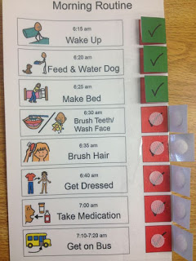
Creating Visual Schedules
Individual Schedules
  Looks like the meeting schedule but in a smaller, portable format.
  May be helpful for the student to take the personal schedule home.
  Talk to the parents and show how you use schedules in your room.
  Providing one to any child who asks can help the one who needs it to feel more like the other children.
Notes:
Individual Schedules Pages 19-20
Some children may have difficulty following a visual schedule on the wall and would do better with a personal schedule they can keep with them.
A more simplified individual schedule does not necessarily have any images or words. It indicates how many segments there are in the session.
Attach Velcro to cardstock and pennies ore small laminated pieces of card stock.
When the child arrives, give her the card and tell her, “We have nine things to do and then it’s time to go home.”
As each segment is completed, have her remove a token.

Slide 23
Managing Behaviors
Ways to help children
before
unexpected behaviors arise:
  Post a list with a few, simple rules.
  Review rules.
  Refer to specific rules.
  When problems arise, refer to the list.
Notes:
Managing Behaviors Pages 23-24
What do you do when children have undesirable behaviors or seem unmanageable in your class?
Having a classroom system and rules for all children is one of the most important things teachers do.
Before we discuss system and rules, we’ll discuss reasons why we may see unexpected behaviors.
Reasons for unexpected behavior:
Children with limited language may feel or want something but not have an appropriate way to express it.
A child can become overwhelmed with sensory input, such as noises that are too loud or lights that are too bright.
They may have participated for a while and need take a quiet break before they can rejoin the group.

Slide 24
Managing Behaviors
  There are several ways to help children when unexpected behaviors arise:
    Remain calm and quiet.
    Reassure the other children that everything is okay.
    Talking to the child while he is upset isn’t the right time.
    Express your love and acceptance.
    Assure parents that you want to learn how to help.
    Follow your church’s procedures for writing a report and debriefing.
Notes:
Managing Behaviors Pages 23-24
If unexpected behaviors do arise, safety of all children in the classroom is paramount..
After you’ve reviewed this slide, ask:
1. Do you have any additional practices they would recommend?
2. Do you know their church’s policy regarding behavior?

Slide 25
Modeling and
Training
Focus on the Person
Inclusion
Focus on Strengths
Direct Communication
Don’t Make Assumptions
Accept Differences
Nurture a Healthy Environment
Notes:
Modeling and Training Pages 25-26
You are a role model to all the children in your class of what it means to love and include those with disabilities. Here are some ways you can do that naturally.

Slide 26
How Can I Support Families with Children Who Have Disabilities?
Notes:
How Can I Support Families with Children Who Have Disabilities? Pages 27-28
Working in Kids’ Ministries we really minister to the whole family
Our goal is to partner with the parents- to encourage and support them
Provide resources:
Book suggestions
Possible story from book
My personal experience- keep asking, keep offering. Reference last section in Momentum book
websites

Slide 27

Teaching for Eternity!
The Bible clearly communicates that children are the heart of God and He made each and every child to be perfect in His sight.
Psalm 139:13-14 says, “For you created my inmost being; you knit me together in my mother’s womb. I praise you because I am fearfully and wonderfully made; your works are wonderful, I know that full well.” (NIV)
Notes:
Teaching for Eternity Page 29
The next time a new family brings their child to your classroom and tells you he might need some extra support, be confident.

