Slide 1


Principles For The Leader’s Marriage
A Woman’s Perspective

Slide 2
Principles For The Leader’s Marriage
A Woman’s Perspective

Slide 3
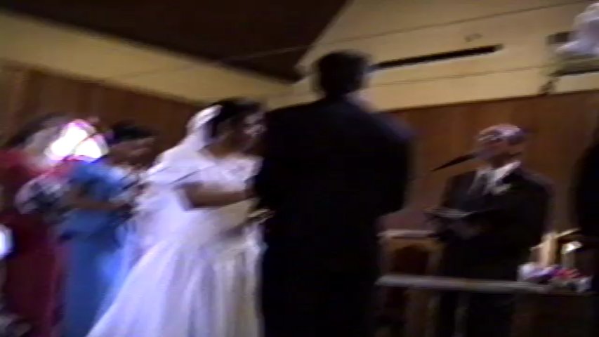

Slide 4
Principles For The Leader’s Marriage
A Woman’s Perspective

Slide 5
Don’t Lose Your Identity
Seven Life Principles

Slide 6
John 1:12
Yet to all who did receive him, to those who believed in his name, he gave the right to become children of God.

Slide 7
John 1:13
–children born not of natural descent, nor of human decision or a husband’s will, but born of God.

Slide 8
A Woman’s Perspective

Slide 9
Psalm 139:1-2
You have searched me, Lord, and you know me. ²You know when I sit and when I rise;…

Slide 10
Psalm 139:13
For you created my inmost being; you knit me together in my mother’s womb.

Slide 11
Psalm 139:14
I praise you because I am fearfully and wonderfully made; your works are wonderful, I know that full well.

Slide 12
A Woman’s Perspective

Slide 13
You Are Called
Seven Life Principles

Slide 14
Psalm 139:15
My frame was not hidden from you when I was made in the secret place, when I was woven together in the depths of the earth.

Slide 15
Psalm 139:16
Your eyes saw my unformed body; all the days ordained for me were written in your book before one of them came to be.

Slide 16
Isaiah 43:1
But now, this is what the Lord says — he who created you, Jacob, he who formed you, Israel: “Do not fear, for I have redeemed you; I have summoned you by name; you are mine.

Slide 17
Ephesians 2:10
For we are God’s handiwork, created in Christ Jesus to do good works, which God prepared in advance for us to do.

Slide 18
2 Timothy 1:6
For this reason I remind you to fan into flame (Stir up) the gift of God, which is in you through the laying on of my hands.

Slide 19
A Woman’s Perspective

Slide 20
Submit And Uplift
Seven Life Principles

Slide 21
Ephesians 5:1-2
Follow God’s example, therefore, as dearly loved children ² and walk in the way of love, just as Christ loved us and gave himself up for us as a fragrant offering and sacrifice to God.

Slide 22
Ephesians 5:21
Submit to one another out of reverence for Christ.

Slide 23
John 13:34
A new command I give you: Love one another. As I have loved you, so you must love one another.

Slide 24
1 Thessalonians 5:11
Therefore, encourage one another and build each other up, just as in fact you are doing.

Slide 25
Hebrews 10:24
And let us consider how we may spur one another on toward love and good deeds,

Slide 26
A Woman’s Perspective

Slide 27
Pray
Seven Life Principles

Slide 28
James 5:16-18 (MSG)
Make this your common practice: Confess your sins to each other and pray for each other so that you can live together whole and healed.

Slide 29
James 5:16-18 (MSG)
The prayer of a person living right with God is something powerful to be reckoned with. Elijah, for instance, human just like us, prayed hard that it wouldn’t rain, and it didn’t -not a drop for three and a half years.

Slide 30
James 5:16-18 (MSG)
Then he prayed that it would rain, and it did. The showers came and everything started growing again.

Slide 31
1 Peter 3:10-12
¹⁰ For, “Whoever would love life, and see good days must keep their tongue from evil and their lips from deceitful speech. ¹¹ They must turn from evil and do good; they must seek peace and pursue it.

Slide 32
1 Peter 3:10-12
¹² For the eyes of the Lord are on the righteous and his ears are attentive to their prayer, but the face of the Lord is against those who do evil.

Slide 33
Show Affection And Date
Seven Life Principles

Slide 34
1 Corinthians 7:5
⁵ Do not deprive each other except perhaps by mutual consent and for a time, so that you may devote yourselves to prayer. Then come together again so that Satan will not tempt you because of your lack of self-control.

Slide 35
Hebrews 13:4
⁴ Marriage should be honored by all, and the marriage bed kept pure.

Slide 36
Be Watchful
Seven Life Principles

Slide 37
Beware of the 3 R’s
Roadblocks
Red Flags
Rhythms
A Women’s Perspective

Slide 38
James 4:1-3
¹ What causes fights and quarrels among you? Don’t they come from your desires that battle within you?

Slide 39
James 4:1-3
² You desire but do not have, so you kill. You covet but you cannot get what you want, so you quarrel and fight. You do not have because you do not ask God.

Slide 40
James 4:1-3
³ When you ask, you do not receive, because you ask with wrong motives, that you may spend what you get on your pleasures.

Slide 41
Beware of the 3 R’s
Roadblocks
Red Flags
Rhythms
A Women’s Perspective

Slide 42
Proverbs 31:27
²⁷ She watches over the affairs of her household and does not eat the bread of idleness.

Slide 43
Recognize the 3 R’s
Roadblocks
Red Flags
Rhythms
A Women’s Perspective

Slide 44
Ecclesiastes 3:1
¹ There is a time for everything, and a season for every activity under the heavens:

Slide 45
Communicate
Seven Life Principles

Slide 46
Colossians 4:6
⁶ Let your conversation be always full of grace, seasoned with salt, so that you may know how to answer everyone.

Slide 47
James 1:19-20
¹⁹ Everyone should be quick to listen, slow to speak and slow to become angry, ²⁰ because human anger does not produce the righteousness that God desires.

Slide 48
Proverbs 18:13
¹³ To answer before listening—that is folly and shame .

Slide 49
Proverbs 15:1
¹ A gentle answer turns away wrath, but a harsh word stirs up anger .

Slide 50
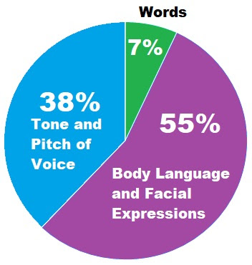
A Women’s Perspective

Slide 51
“Everyone is watching you.
Forgive Continually”
(Tina Hook 3/25)
A Women’s Perspective

