Slide 1
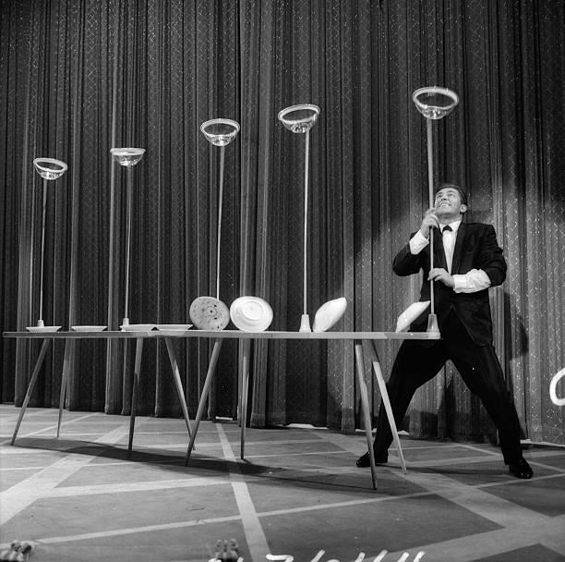

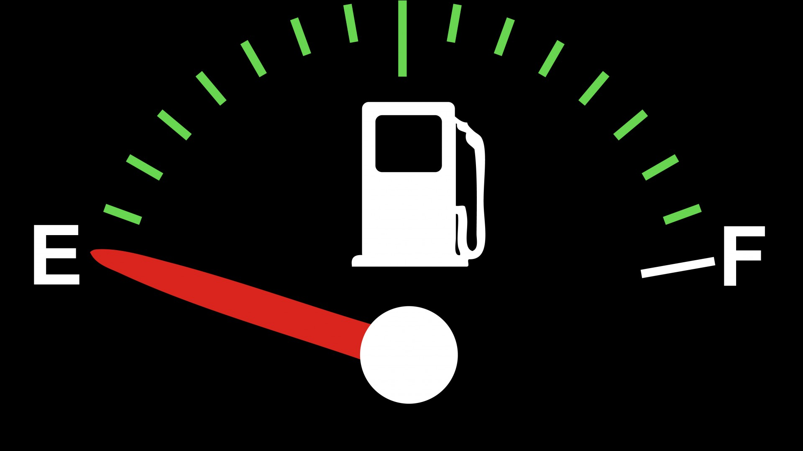
REFUELING WHEN YOU ARE EMPTY
(AND BURNED OUT)

Slide 2
WHAT IS MINISTRY BURNOUT?
  MINISTRY BURNOUT REFERS TO PHYSICAL, EMOTIONAL, AND/OR MENTAL EXHAUSTION INTERTWINED WITH DOUBTS ABOUT ONE’S ABILITIES AND THE VALUE OF THEIR WORK.
  HAMSTER WHEEL – GOING AND GOING AND GOING AND GOING NOWHERE WITH NO END IN SIGHT
  JUST PLUMB WORN OUT AND CAN’T RECOUP EVEN AFTER REST/VACATION
  NOT TALKING ABOUT A BUSY SEASON BUT AN
  ONGOING, LENGTHY, NO END IN SIGHT OVERLOAD.

Slide 3
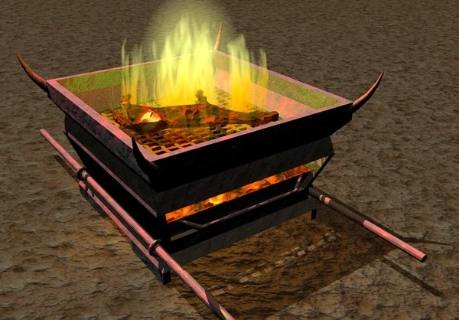
THE TIME FOR BURNT OFFERINGS IS OVER!

Slide 4
SIGNS OF MINISTRY BURNOUT
  PHYSICAL SIGNS
    CONSTANT TIREDNESS AND LETHARGY, EVEN AFTER PERIODS OF REST
    WEIGHT GAIN (POOR EATING HABITS), INSOMNIA, DON’T WANT TO GET OUT OF BED
    HIDDEN ADDICTIONS

Slide 5
SIGNS OF MINISTRY BURNOUT
  EMOTIONAL SIGNS
    CYNICISM, IRRITABILITY, ANGER, ANXIETY, DEPRESSION, HOPELESSNESS, BEGRUDGING, EMOTIONAL OUTBURSTS, EMOTIONAL WITHDRAWAL; LACK OF JOY
    “DROWNING” – YOU FEEL LIKE YOU ARE IN WAY OVER YOUR HEAD AND NOBODY CARES AND THEY SHOULD CARE – THEY SHOULD BE HELPING AND TAKING THE BURDEN OFF OF YOU.
    “IF ONLY THERE WERE MORE HOURS IN THE DAY”

Slide 6
SIGNS OF MINISTRY BURNOUT
  RELATIONAL SIGNS
    FEEL ISOLATED AND DISCONNECTED FROM THE CHURCH AND GOD
    “MINISTRY WOULD BE GREAT IF IT WASN’T FOR THE PEOPLE!”
    OTHERS ARE SAYING YOU ARE DOING TOO MUCH AND YOU SHOULD LEARN TO SAY “NO”.
    COMPLAINING…A LOT

Slide 7
SIGNS OF MINISTRY BURNOUT
  SPIRITUAL SIGNS
    DREAD FOR SUNDAY
    SPIRITUAL FATIGUE, DRYNESS AND LOSS OF ZEAL FOR MINISTRY
    COMPASSION FATIGUE
    TOO BUSY TO BE WITH JESUS – PRAYER, READING YOUR BIBLE FALL BY THE WAYSIDE
    FEELS MECHANICAL AND YOU DON’T PREP LIKE YOU USED TO – LACK OF MOTIVATION
    OVERCOMMITTED AND “UNDER APPRECIATED” BUT DON’T KNOW HOW TO “FIX IT”
    “IF I DON’T DO IT, NOBODY WILL.”

Slide 8
UNIQUE PRESSURES OF MINISTRY
  “SOULS ARE IN THE BALANCE.”
  WHAT ABOUT JAMES 2:17?
  “JESUS DID ALL FOR ME, IT’S THE LEAST I CAN DO FOR HIM.”
  GUILT
  WHAT ABOUT MATTHEW 9:37-38?
  EXPECTATIONS OF OTHERS TO BE ALL THINGS TO ALL PEOPLE
  NEVER REALLY OFF THE CLOCK – ALWAYS A PASTOR, ETC.
  ALWAYS GIVING
  FELT NEED TO ALWAYS BE ACCESSIBLE

Slide 9
WHY REFUEL?
  BITTERNESS AND BURN OUT GO HAND IN HAND – IT WILL DESTROY YOU IF YOU LET IT
  YOUR RELATIONSHIP WITH GOD IS WORTH IT
  YOUR SALVATION IS WORTH IT
  YOUR HEALTH IS WORTH IT
  YOUR FAMILY IS WORTH IT
  THE BEST IS YET TO COME
  GOD HAS THINGS AHEAD THAT ARE PART OF HIS PLAN FOR YOU

Slide 10
STRATEGIES TO PREVENT BURNOUT
AND REFUELING
WISDOM IS THE RIGHT USE OF KNOWLEDGE. TO KNOW IS NOT TO BE WISE. MANY MEN KNOW A GREAT DEAL, AND ARE ALL THE GREATER FOOLS OR IT. THERE IS NO FOOL AS A KNOWING FOOL. BUT TO KNOW HOW TO USE KNOWLEDGE IS TO HAVE WISDOM.”
- CHARLES SPURGEON

Slide 11
STRATEGIES TO PREVENT BURNOUT
AND REFUELING
  GET A PHYSICAL
  WHAT PUTS FUEL IN YOUR TANK?
  PRIORITIES CHECKLIST
    PRIORITIZE YOUR RELATIONSHIP WITH GOD, YOUR HEALTH, YOUR FAMILY
    EVALUATE WHAT AND WHY YOU DO WHAT YOU DO
  SPEND MORE TIME IN PRAYER, IN THE WORD, IN WORSHIP
  REGAIN LOST VISION FOR MINISTRY
  STOP COMPARING YOURSELF TO OTHERS
  DEVELOP RELATIONSHIPS WITH NON-CHRISTIANS

Slide 12
STRATEGIES TO PREVENT BURNOUT
AND REFUELING
  FOCUS ON THE POSITIVE
  HAVE FUN AND LAUGH
  CUT OFF DRAINING RELATIONSHIPS
  EXPRESS GRATITUDE
  DO ACTIVITIES THAT ENERGIZE YOU
  SPEND MORE TIME IN PRAYER, IN THE WORD, IN WORSHIP
  GET IN BETTER PHYSICAL SHAPE
  RECOMMIT TO HAVE THE SPIRIT OF A SERVANT
  SABBATH

Slide 13
STRATEGIES TO PREVENT BURNOUT
AND REFUELING
  DELEGATE AND ASK FOR HELP
  MARGINS
  TAKE A BREAK
  ATTEND THINGS THAT YOU JUST SHOW UP FOR AND DON’T HELP!
  SPEND MORE TIME IN PRAYER, IN THE WORD, IN WORSHIP
  BOUNDARIES
  START MAKING CHANGES
  PLAN AHEAD

Slide 14
STRATEGIES TO PREVENT BURNOUT
AND REFUELING
  STOP COMPARING
  GET OFF THE HAMSTER WHEEL
  DON’T BUY INTO “IF YOU NOTICE IT, GOD WANTS YOU TO DO IT”
  SAY NO TO EVEN GOOD THINGS
  WHAT DOES THE LORD REQUIRE OF YOU - MICAH 6:8
  MOSES AND JETHRO – EXODUS 18
  ALWAYS ANOTHER CALL TO MAKE, ANOTHER VISIT, ANOTHER EMAIL TO ANSWER, TEXT, ANOTHER LESSON/MESSAGE, ANOTHER EVENT
  IRRESPONSIBLE RESPONSIBILITY

Slide 15
CAN I COME BACK FROM BURNOUT?
  YES!
  ELIJAH – 1 KINGS 19
  PETER – MATTHEW 14
    GOES TO JESUS ON THE WATER
    STARTS TO DROWN
    JESUS REACHES OUT TO HIM AND LIFTS HIM UP AND TAKES HIM BACK TO THE BOAT.

Slide 16
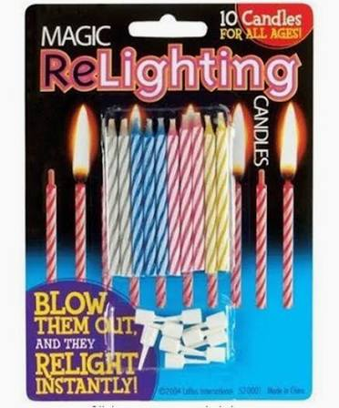
CAN I COME BACK FROM BURNOUT?
  Matthew 11:28-30
  1 Corinthians 15:58
  2 Corinthians 4:1
  John 15:1-5
  Isaiah 40:31
  Matthew 14:13
  Psalm 46:1-3
  Matthew 28:18-20
  1 Corinthians 6:19-20
  James 4:10
  Mark 6:31

Slide 17
RESOURCES
LEADING ON EMPTY BY WAYNE CORDEIRO
THE RUTHLESS ELIMINATION OF HURRY BY JOHN MARK COMER
NECESSARY ENDINGS BY DR. HENRY CLOUD
BOUNDARIES (others in series) BY DR. HENRY CLOUD
EMOTIONALLY HEALTHY SPIRITUALITY (others in series) BY PETER SCARZZERO
PRACTICING THE WAY BY JOHN MARK COMER
EXPERIENCING GOD BY HENRY & RICHARD BLACKABY
RIGHTNOWMEDIA.ORG

