Slide 1

BUILDING COMMUNITY THROUGH CHRIST-CENTERED CONNECT GROUPS
CAREN PETFIELD | SESSION #1
10:10-10:40AM

Slide 2
SMALL GROUPS FOSTER:
AUTHENTIC RELATIONSHIPS
SPIRITUAL GROWTH
BIBLICAL DISCIPLESHIP

Slide 3

THE VALUE OF COMMUNITY
IF YOU WANT TO GROW A CROWD, BUILD A SERVICE
IF YOU WANT TO GROW DISCIPLES, BUILD COMMUNITY

Slide 4


WHY SMALL GROUPS MATTER?
Faith moves from something
we hear to something we live
SERVICES
SMALL GROUPS
Services are powerful,
but they are mostly
one-directional
Small groups create relational environments

Slide 5
ATTENDING vs BEING KNOWN
SERVICES GATHER,
BUT GROUPS TRANSFORM
SERVICES INTRODUCE PEOPLE TO JESUS, BUT GROUPS HELP PEOPLE BECOME LIKE JESUS

Slide 6


BIBLICAL DISCIPLESHIP: GROW LARGER AND SMALLER AT THE SAME TIME
GROW LARGER THROUGH EVANGELISM
GROW SMALLER THROUGH COMMUNITY

Slide 7
JESUS MODELED THIS
DISCIPLESHIP IS NOT JUST INFORMATIONAL - IT’S RELATIONAL

Slide 8
WHY THIS MATTERS?
People are around church, but not always connected in a way that leads to transformation

Slide 9
BUILDING A HEALTHY SMALL GROUP NETWORK
START WITH A CLEAR DISCIPLESHIP PATH
___
“THIS IS HOW WE GROW”

Slide 10

SMALL GROUP DISCIPLESHIP
@ REACH
REACH GROUP Semesters
6-8 Weeks Per Semester
  Fall (Oct-Nov)
  Winter (Feb-Mar)
  Spring (May-June)
  Groups During Breaks

Slide 11
DIFFERENT TYPES OF REACH GROUPS MEET ON VARIOUS DAYS, TIMES & LOCATIONS
SPIRITUAL GROWTH GROUPS
LIFE & DISCIPLESHIP GROUPS
PRAYER GROUPS & ENCOUNTERING GOD STUDIES
BOOK CLUBS
ACTIVE & FIT GROUPS
COMMUNITY & CARE GROUPS

Slide 12
BUILDING A HEALTHY SMALL GROUP NETWORK
BUILD AROUND RELATIONSHIPS,
NOT JUST CONTENT

Slide 13
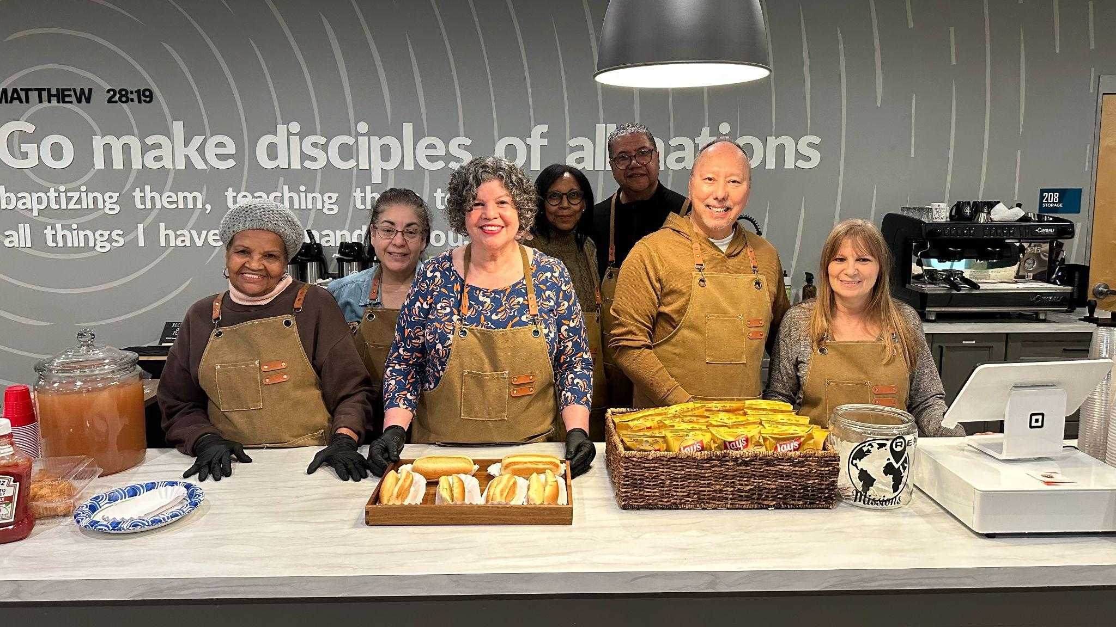

Slide 14
BUILDING A HEALTHY SMALL GROUP NETWORK
DEVELOP LEADERS CONTINUOUSLY

Slide 15
ABOUT DEVELOPING LEADERS
LOOK FOR THE FAITHFUL,
AVAILABLE, AND TEACHABLE
___
WE NEED YOU vs WE WANT YOU

Slide 16
SUSTAINING A HEALTHY NETWORK
KEEP THE VISION IN FRONT OF THE PEOPLE
SUPPORT YOUR LEADERS WELL
STAY FLEXIBLE
DEPEND ON THE HOLY SPIRIT

Slide 17
NO ONE SHOULD WALK INTO OUR CHURCHES AND REMAIN UNKNOWN
ATTENDING
BELONGING
GROWING
LEADING

Slide 18
NEXT STEPS
What is one step you can take to strengthen your small group network?
What structure could you create that actually works for your people?
Who is one person you can begin developing as a leader?

Slide 19
WE’RE BUILDING DISCIPLES!
WE’RE NOT JUST BUILDING GROUPS

Slide 20

pastorcaren@reachny.church
WE NEED EACH OTHER
LET’S COLLABORATE!

