Slide 1





ESSENTIAL TARGETS
FOR NEXTGEN MINISTRIES
Notes:
Today we will hit on the following 4 areas of NetGen Ministries
KidMin, YouthMin, RR, & GM
Next Slide

Slide 2








TOPICS:
LEARNING & MEMORIZATION
ENCOUNTERING THE HOLY SPIRIT
HEARING THE CALL OF GOD
HONORING FAMILY STRUCTURE
Notes:
Read the four
Learning & Memorization Next slide

Slide 3




LEARNING & MEMORIZATION
  Interactive & Creative lessons
    Object lessons
    Visual & Sensory options
  Games & Team Activities
  Songs
  Relationship Building
  Rewards
Make the Bible COME ALIVE
Notes:
This target area can be hard but is the most Vital one of all as we Disciple these students to become Followers of Jesus Christ LONG TERM.
Bible fluency is the ability to confidently navigate, understand, and apply the storyline, characters, and themes of the Bible to everyday life, moving beyond mere literacy to internalizing its message.
Core Aspects of Biblical Fluency
Beyond Literacy: While literacy focuses on knowing facts, fluency focuses on navigating the "thought-world" of the Bible and applying its principles.
Contextual Understanding: It requires understanding the original context, including the author's intent and genre.
Mental Mapping: It helps individuals map their way through the Bible, understanding how the Old and New Testaments connect, centering on Jesus Christ.
Habitual Study: It is developed through regular reading and engagement, not just passive listening.
So How Do we Help students become Biblically Fluent?
Interactive & Creative Teaching
Active Storytelling: Use props and role-playing to act out Bible stories.
Object Lessons: Bring in mysterious or relevant items, such as a "rotten fruit" for a lesson on sin or a flashlight to illustrate bringing light to the world.
Visual & Sensory Learning: Utilize videos, maps, and diagrams to cater to visual learners, and create sensory experiences like smelling spices or feeling rough textures to bring stories to life.
Themed Days: Allow pajama days, silly hat days, or rearrange the room furniture to break the monotony.
Games & Team Activities
Active Games: Play games like Duck Duck Goose, Hot Potato, or scavenger hunts based on the lesson, say Better Bible Teachers.
Relay Races: Adapt Bible stories into physical challenges. (3x5 cards example)
Songs & Rewards
Interactive Music: Encourage loud singing, silly actions, or singing upside down.
B.I.B.L.E., I am a CH…
Psalms 150:6 (NIV)
Let everything that has breath praise the Lord . Praise the Lord .
Psalms 42:1 (NIV)
As the deer pants for streams of water, so my soul pants for you, my God.
Relationship Building
Small Group Focus: Sit on the floor in a circle for more intimate discussion and connection, especially for smaller classes.
Empower Kids: Let children lead, such as holding props, helping with a skit, or praying for each other.
Psalms 119:11 (NIV)
I have hidden your word in my heart that I might not sin against you.
Psalms 119:105 (NIV)
Your word is a lamp for my feet, a light on my path.
Isaiah 41:10 (NIV)
So do not fear, for I am with you; do not be dismayed, for I am your God. I will strengthen you and help you; I will uphold you with my righteous right hand.
Be an Example – Learn along with them
Remember this Key componant (NEXT SLIDE)

Slide 4
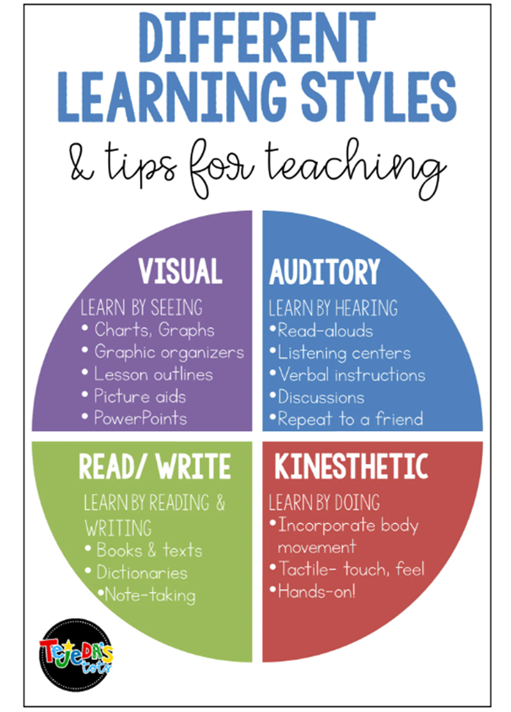







Notes:
Your students will be a mix of multiple learning styles and personalities - so when planning your topics/lessons/messages find was to hit all of these areas

Slide 5


WHO IS THE H.S.
  Healer
  Helper
  Comforter
  Healer
  Helper
  Comforter
  Guide
  Powerful
  Gift Giver
  ???
ENCOUNTERING THE HOLY SPIRIT
WHO HAS ACCESS TO THE H.S.
The Holy Spirit is alive and moving
  HE IS REAL
  HE IS ACTIVE
  HE IS FOR EVERDAY
EVERYONE - NO MATTER WHAT AGE
HOW DOES THE HS TALK TO ME
  In a whisper
  Knowledge of truth
  Warm feeling
  Dreams
  Prayer
  Other people
  ???
Notes:
How Kids Encounter the Holy Spirit
"Inward Witness": Children often feel the Holy Spirit as a quiet inner voice or a sense of warmth.
Conversational Prayer: Simply asking the Holy Spirit to be present can lead to experiences of love or peace.
Dreams and Visions: Children are often receptive to spiritual insights through dreams.
Intuition of Truth: The Holy Spirit helps children understand right from wrong, and truth from falsehood.
Active Ministry: Children can participate in prayer for healing, worship, and ministering to others.
Guiding Children's Experiences
Practice Listening: Ask children to be quiet and still, encouraging them to share what they think God is telling them.
Simple Language: Use simple terms and avoid making the concept too complex. The Spirit acts as a helper, teacher, and guide.
Affirmation: Even if a child's understanding seems partial, affirm their efforts and encourage them to continue seeking, as hearing the Spirit takes practice.
Bible Stories: Use stories like Pentecost to illustrate the Spirit's power.
Avoid Skepticism: Children often easily believe in the supernatural; adult unbelief is a common hindrance to their spiritual experiences.
Common Misconceptions
No "Junior" Spirit: Children receive the same, full Holy Spirit as adults, not a lesser version.
Not Just for Church: The Holy Spirit works in everyday life—convicting them when they do wrong and helping them be patient or kind.

Slide 6

HEARING THE CALL OF GOD:
CREATE AN ATMOSPHERE OF ANTICIPATION
WHAT HAS GOD GIVEN YOU TO USE FOR HIM
Notes:
Helping students hear the call of God involves creating environments where they can recognize and respond to His voice. This is a process
Key Strategies for Discernment
Teach the Language of God: Help students understand that God speaks through various channels, including Scripture, promptings of the Holy Spirit, their conscience, and the counsel of godly mentors.
Prioritize Stillness: Create intentional moments of silence in your meetings. Learning to hear God requires practice in "tuning out" external and internal noise.
Model the Process: Share your own stories of how you heard and obeyed God’s voice. Your lived experience and transparency about the process of obedience are powerful teaching tools.
Encourage Spiritual Disciplines: Commit to helping students develop daily habits of prayer and Bible study. A personal walk with God is the foundation for recognizing His specific calls for their lives.
Provide Serving Opportunities: Sometimes a call is discovered through action. Empower students to serve in their areas of passion to help them identify their spiritual gifts and vocational path.
Practical Tools and Resources
Prayer Journals: Encourage students to write down their thoughts and prayers during quiet times. This helps them track patterns and "confirmation" over time.
Vocational Mentoring: Connect students with adults who can offer experiential wisdom and help them test if what they feel is consistent with God's character.
Curriculum
Youth Conferences: Events such as the West Coast Baptist Youth Conference can provide concentrated environments for students to surrender to whatever call God may have for them.

Slide 7


PARTICIPATION AND COLLABORATION OF PARENTS AND TEACHERS
Notes:
Next Generation leaders can bridge the gap between church and home by shifting from a "drop-off" program model to a strategic partnership that equips parents as the primary spiritual influencers.
Core Strategies for Connection
Equip Parents as "Team A": Position the church as the support system ("Team B") for parents, who have the most daily influence. Provide tangible resources like weekly discipleship guides with conversation starters and memory verses to help them build spiritual habits during everyday moments.
Foster Personal Relationships: Move beyond pulpit announcements by listening to families first. Intentionally learn parents' names, meet for coffee to understand their family dynamics, and offer to pray for their specific needs.
Create Intergenerational Rhythms: Design spaces where multiple generations interact, such as cross-generational prayer partnerships or inviting older members to share their faith stories during worship services.
Host "Parent Weekends": Invite parents to experience kids' or youth church firsthand. Seeing the ministry in action builds trust and makes them more likely to engage in follow-up conversations about their child's spiritual growth. Fuller Youth Institute +8
Practical Implementation Tools
Family-Friendly Events: Use hospitality (e.g., game nights or BBQs) to build trust and strengthen relationships outside of formal service times.
Virtual Small Groups: For busy families, offer virtual options or small groups with a low leader-to-student ratio (around 8:1) to maintain personal connections when physical attendance is difficult.
Leadership Pipelines: Create visible paths for students and children to serve alongside adults, showing them they are a vital part of the "church of today," not just the future.
Encourage parents to come back to the table in gentle ways – Conversation cards, Simple Prayer before kids/Parents leave for the day…Start small

Slide 8
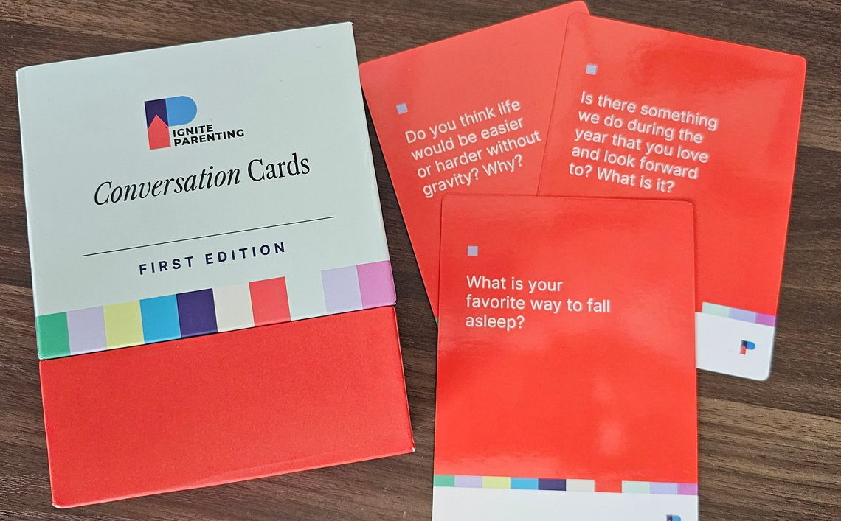



Slide 9


F+F+F=
SPIRITUAL GROWTH OPPORTUNITIES
BIBLICAL FLUENCY
FUN & INTERACTIVE
FULL (PERSONAL) OWNERSHIP

Slide 10


FINAL THOUGHTS
  Ministry ISN’T one size fits all
    Be like Gumby (Flexible)
  Relational Discipleship MAKES the difference from generation to generation (Know them)
  ALL students matter (Quirks and all)
  God loves the littles (He wants them to come to him)

