Slide 1



Theology of Worship:
A biblical model for contemporary Worship

Slide 2
First Mention of the word worship
Gen 22:5
Notes:
Let’s read this Verse – Next Slide

Slide 3
He said to his servants, “Stay here with the donkey while I and the boy go over there. We will worship and then we will come back to you.”
Gen 22:5
Notes:
Moses Obeyed
Moses Was willing to give his most valuable thing to God as an offering. Issacc
Moses was willing to Sacrifice and Trust

Slide 4
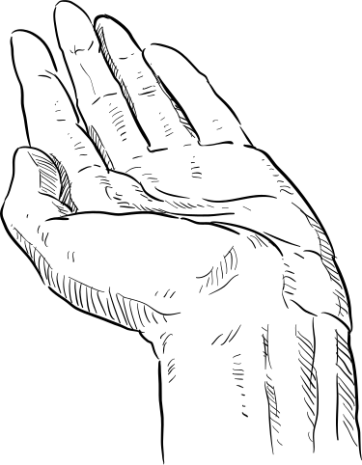
True Worship is
Obedience and Surrender

Slide 5

Goes beyond the exteral and speaks to the condition of the heart
Notes:
Moses’s heart was surrendered to the will of God. He knew who God was, the honor God deserved, and that obedience brought blessing…

Slide 6
What is a call to worship
*Who do we worship
*Why do we worship
*How do we worship

Slide 7

WHO?
Notes:
God above all else

Slide 8
God is the Audience
Worship is for God.
It’s a sweet foretaste of what Heaven will be like
Notes:
(Exodus 20:3) The First Commandment given from God to His people is to have no other Gods before Him! The commandments were to be on our hearts…
(Luke 4:8) Jesus answered, “It is written: ‘Worship the Lord your God and serve him only.’ ”
Deuteronomy 6:5, Matthew 22:37, Mark 12:30, Luke 10:27 all say: “ ‘Love the Lord your God with all your heart and with all your soul and with all your strength and with all your mind’

Slide 9
Why?

Slide 10
Formational
An Ecnounter
Anticipatory
Notes:
Formational - Shapes a believers heart and understanding to reflect the character of Christ.
An Encounter - Corporate worship provides an opportunity for you to experience the living Christ and the Holy Spirits presence.
Anticipatory - We mirror heavenly worship described in Revelations as we look forward to the final day we are with Him in Heaven.
*All Creation was made to worship
Luke 19:40) “I tell you,” he replied, “if they keep quiet, the stones will cry out.”,
(Ps 150:6) Let everything that has breath praise the Lord . Praise the Lord
*Relationship/Connection with God
*Alignment of human Heart to Divine Purpose
*Warfare (II Chronicles 20:22) 2 Chronicles 20:22 (NIV)
As they began to sing and praise, the Lord set ambushes against the men of Ammon and Moab and Mount Seir who were invading Judah, and they were defeated. Walls of The Fall Of Jericho…Silent for 7 days but then!
Gideon’s Victory.. With a shout and trumpets the enemies fought themselves
Paul & Silas worshipping in Prison – Broke physical chains and opened the doors
Spiritual Warfar – David worshipping God in Saul's presence caused the evil Spirits to flee
*Transforming and renewing of our minds – To know His will.
(Romans12:2) Do not conform to the pattern of this world, but be transformed by the renewing of your mind. Then you will be able to test and approve what God’s will is—his good, pleasing and perfect will.

Slide 11
HOW?

Slide 12
types of worship
Physical
Musical/Vocal
Sacrificial & Service
Liturgical/Corporate worship
Prayer & Adoration
Lifestyle worship
Notes:
Biblical Worship is defined as a holistic devotion to God in all areas of our life...
Physical - Kneeling (Ps 95:6), Bowing, Lifting our hands (Ps 63:4, clapping (Ps 47:1), dancing (Ps 149:3), shouting (Ps 98:4)
Musical/Vocal- Hymns, Psalms, & Spiritual songs (James 5:13)
Sacrificial/Service - Offering/ sacrifices, tithes, serving others
Liturgical/Corporate Worship -
Structured worship, reading of Scripture, sermons, Communion
Prayer & Adoration - Spontaneous and or formal talking with God, praise and thanksgiving.
Lifestyle worship - Offering your daily life as a living sacrifice to God. (Romans 12:1)

Slide 13
"God is Spirit, and those who worship Him must worship in spirit and truth".
John 4:24 (NKJV):
Notes:
Faith – Let Faith Rise up oh heart believe. Let Faith rise up in me!
Not a formality, a box to be checked
But is a Focusing on His Character and not ours.

Slide 14
Key Principles
Notes:
God is the Audience and Goal:
Worship is primarily for God, not for human enjoyment, functioning as a "sweet foretaste" of heavenly worship.
Christ-Centered Mediator:
Worship is only possible through Jesus Christ, acting as the mediator between God and humanity.
A Comprehensive Lifestyle:
True worship is not limited to Sunday but involves all of life (Rom 12:1), including service to others. Romans 12:1 (NIV) reads: "Therefore, I urge you, brothers and sisters, in view of God’s mercy, to offer your bodies as a living sacrifice, holy and pleasing to God—this is your true and proper worship
Dialogic and Covenantal: Worship is a conversation—
a dialogue between God (who calls and reveals) and people (who respond). It renews the covenantal relationship between God and His people.
Scripture-Driven:
Worship must be rooted in the Bible, including the reading, preaching, and singing of Scripture.
Reverence and Adoration:
Worship implies submission to the Divine Sovereign (hishakawa/proskuneo), acknowledging His worthiness.

Slide 15
A life lived in obedience, Sacrifice, Surrender, and humility. focused on the who, the Why, and the how.
Notes:
Develops a lifestyle of worship, that encourages others to follow.

Slide 16

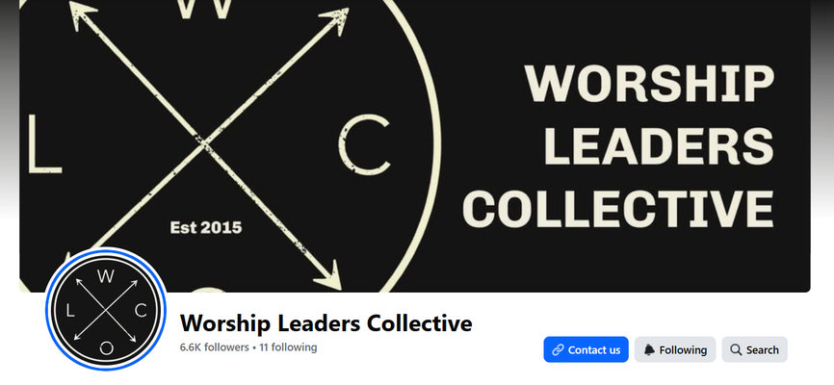
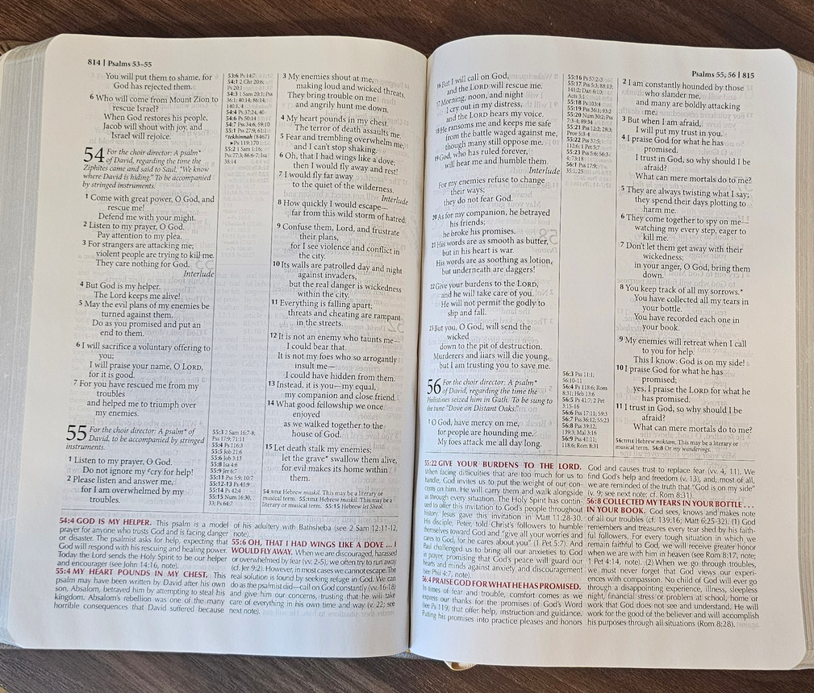
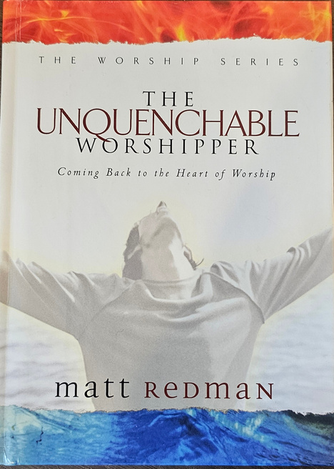
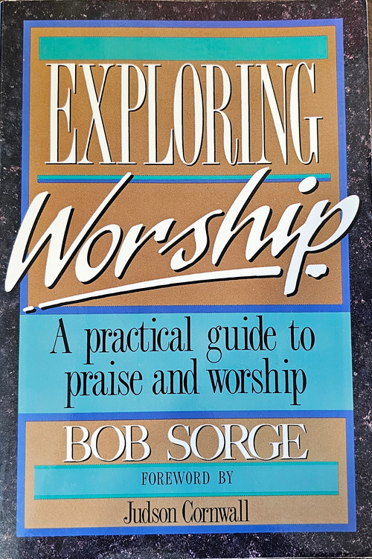
https://www.facebook.com/worshipleaderscollective
Resources

