Slide 1
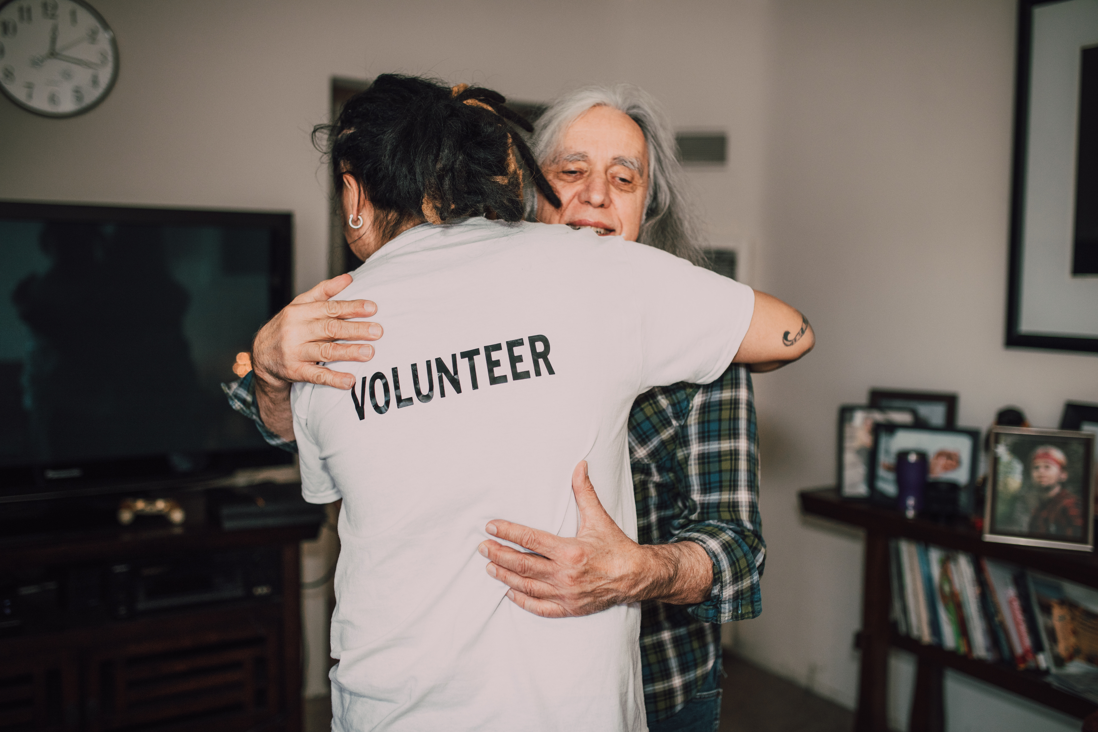
YOU ARE NOT JUST
A VOLUNTEER

Slide 2
YOU ARE NOT FILLING A SPOT
YOU ARE FULFILLING A CALLING
DISCIPLES
John 2:43-46 The next day Jesus decided to leave for Galilee. Finding Philip, he said to him, “Follow me.” Philip, like Andrew and Peter, was from the town of Bethsaida. Philip found Nathanael and told him, “We have found the one Moses wrote about in the Law, and about whom the prophets also wrote—Jesus of Nazareth, the son of Joseph.” “Nazareth!Can anything good come from there?”
Nathanael asked. “Come and see,” said Philip.

Slide 3
YOU ARE NOT FILLING A SPOT
YOU ARE FULFILLING A CALLING
DIVINE APPOINTMENT

Slide 4
ACTS 6:1-10 IN THOSE DAYS WHEN THE NUMBER OF DISCIPLES WAS INCREASING, THE HELLENISTIC JEWS AMONG THEM COMPLAINED AGAINST THE HEBRAIC JEWS BECAUSE THEIR WIDOWS WERE BEING OVERLOOKED IN THE DAILY DISTRIBUTION OF FOOD. SO THE TWELVE GATHERED ALL THE DISCIPLES TOGETHER AND SAID, “IT WOULD NOT BE RIGHT FOR US TO NEGLECT THE MINISTRY OF THE WORD OF GOD IN ORDER TO WAIT ON TABLES. BROTHERS AND SISTERS, CHOOSE SEVEN MEN FROM AMONG YOU WHO ARE KNOWN TO BE FULL OF THE SPIRIT AND WISDOM. WE WILL TURN THIS RESPONSIBILITY OVER TO THEM AND WILL GIVE OUR ATTENTION TO PRAYER AND THE MINISTRY OF THE WORD.” THIS PROPOSAL PLEASED THE WHOLE GROUP. THEY CHOSE STEPHEN, A MAN FULL OF FAITH AND OF THE HOLY SPIRIT...

Slide 5
THEY PRESENTED THESE MEN TO THE APOSTLES, WHO PRAYED AND LAID THEIR HANDS ON THEM. SO THE WORD OF GOD SPREAD. THE NUMBER OF DISCIPLES IN JERUSALEM INCREASED RAPIDLY, AND A LARGE NUMBER OF PRIESTS BECAME OBEDIENT TO THE FAITH. NOW STEPHEN, A MAN FULL OF GOD’S GRACE AND POWER, PERFORMED GREAT WONDERS AND SIGNS AMONG THE PEOPLE. OPPOSITION AROSE...BUT THEY COULD NOT STAND UP AGAINST THE WISDOM THE SPIRIT GAVE HIM AS HE SPOKE.

Slide 6
THE KINGDOM OF GOD RUNS ON CALLING, NOT CONVENIENCE
IT COSTS YOU SOMETHING
  TIME CONSUMING
  EMOTIONAL COST
  SPIRITUALLY DEPLETING AND ENERGIZING
  FINANCIAL

Slide 7
YOU ARE PART OF THE BODY
NOT AN ACCESSORY
GOD SEES
YOU ARE NOT INSIGNIFICANT

Slide 8
ROMANS 12:4-8 FOR JUST AS EACH OF US HAS ONE BODY WITH MANY MEMBERS, AND THESE MEMBERS DO NOT ALL HAVE THE SAME FUNCTION, SO IN CHRIST WE, THOUGH MANY, FORM ONE BODY, AND EACH MEMBER BELONGS TO ALL THE OTHERS. WE HAVE DIFFERENT GIFTS, ACCORDING TO THE GRACE GIVEN TO EACH OF US. IF YOUR GIFT IS PROPHESYING, THEN PROPHESY IN ACCORDANCE WITH YOUR FAITH; IF IT IS SERVING, THEN SERVE; IF IT IS TEACHING, THEN TEACH; IF IT IS TO ENCOURAGE, THEN GIVE ENCOURAGEMENT; IF IT IS GIVING, THEN GIVE GENEROUSLY; IF IT IS TO LEAD, DO IT DILIGENTLY; IF IT IS TO SHOW MERCY, DO IT CHEERFULLY.

Slide 9
YOU ARE PART OF THE BODY
NOT AN ACCESSORY
YOU ARE GIFTED
WHEN HE CALLS, HE EQUIPS

Slide 10
ACTS 4:13 WHEN THEY SAW THE COURAGE OF PETER AND JOHN AND REALIZED THAT THEY WERE UNSCHOOLED, ORDINARY MEN, THEY WERE ASTONISHED AND THEY TOOK NOTE THAT THESE MEN HAD BEEN WITH JESUS.
2 CORINTHIANS 4:7 BUT WE HAVE THIS TREASURE IN JARS OF CLAY TO SHOW THAT THIS ALL-SURPASSING POWER IS FROM GOD AND NOT FROM US.

Slide 11
YOU ARE CALLED TO BE STEWARDS
OF HIS GRACE
1 Peter 4: 10 10 Each of you should use whatever gift you have received to serve others, as faithful stewards of God’s grace in its various forms.
        Excellence
        Prayer
        Faithfulness
        In the Word
        Timely
        Prepared

Slide 12
YOUR ATTITUDE MATTERS
YOU ARE ON MISSION FROM THE MASTER
LUKE 10:1 ...THE LORD APPOINTED SEVENTY-TWO OTHERS AND SENT THEM TWO BY TWO AHEAD OF HIM TO EVERY TOWN AND PLACE WHERE HE WAS ABOUT TO GO.
COLOSSIANS 1:27 CHRIST IN YOU,
THE HOPE OF GLORY!

Slide 13
COMMIT TO SERVING WITH
RENEWED PURPOSE
JESUS IS WORTH IT!
Colossians 3:24, 1 Peter 4:23-24,
1 Corinthians 15:58, Acts 8:2

Slide 14
YOU ARE NOT JUST
A VOLUNTEER

